Slide 1

Happyconomics
António Gouveia and
Sofia Scomazzon
HAPPINESS, GDP AND INNOVATION

Slide 2

Project overview
Are happy people more innovative?
4 datasets: World Happiness Report, Global Innovation Index, GDP and GDP per capita
From Kaggle

Slide 3

Data Acquisition
Happiness original dataset being multiple datasets
Supplementar datasets (Innovation and GDP) being essential for the hypotheses

Slide 4

Database Design
ERD
Challanges faced during data importing to the MySQL Workbench

Slide 5
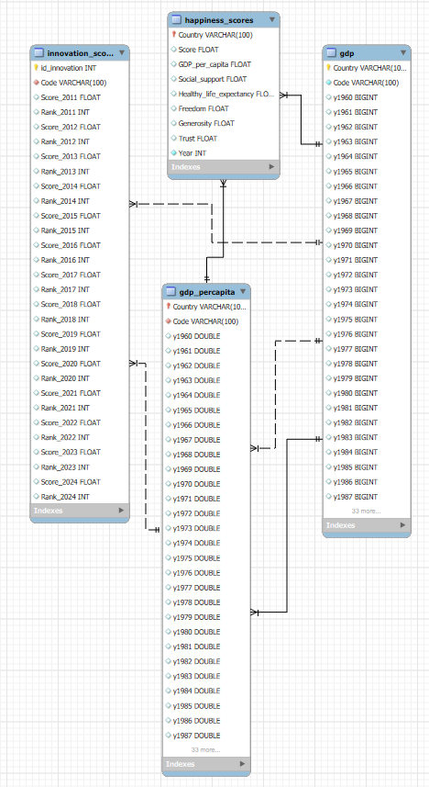

Slide 6

SQL Insights
JOIN all datasets
ORDER BY happiness
WHERE year was 2015
AVG from different years ⟶ CREATE VIEW
Countries > AVG
MAX, MIN, AVG, STD for data

Slide 7
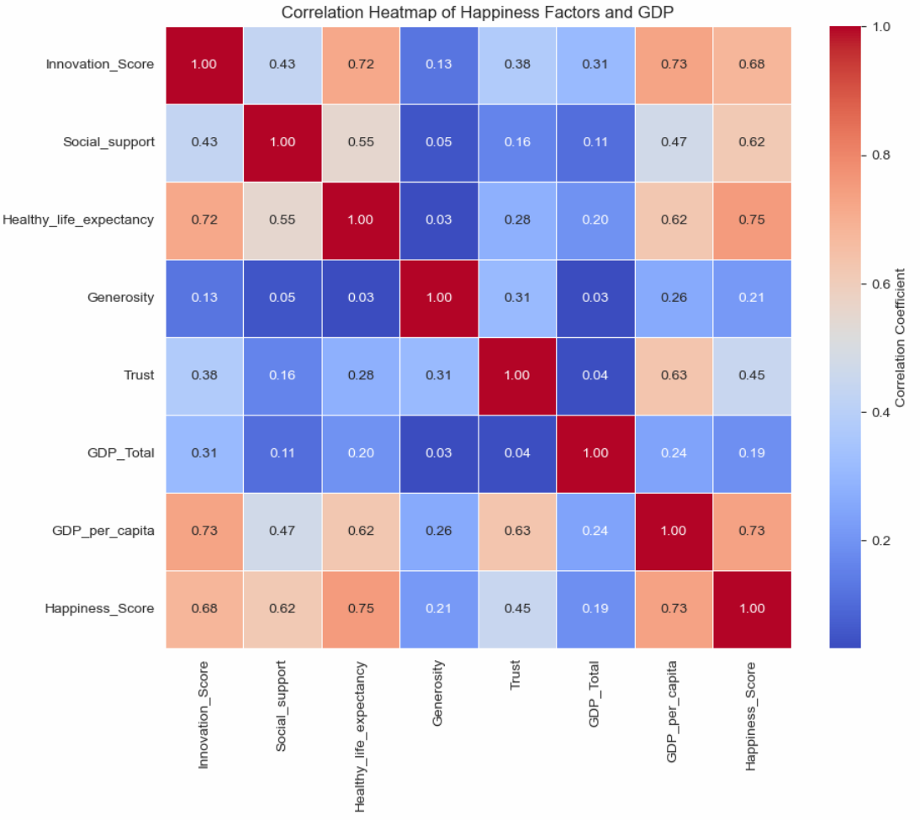
Visualization
Correlations ⟶ happiness x innovation; GDP x innovation

Slide 8
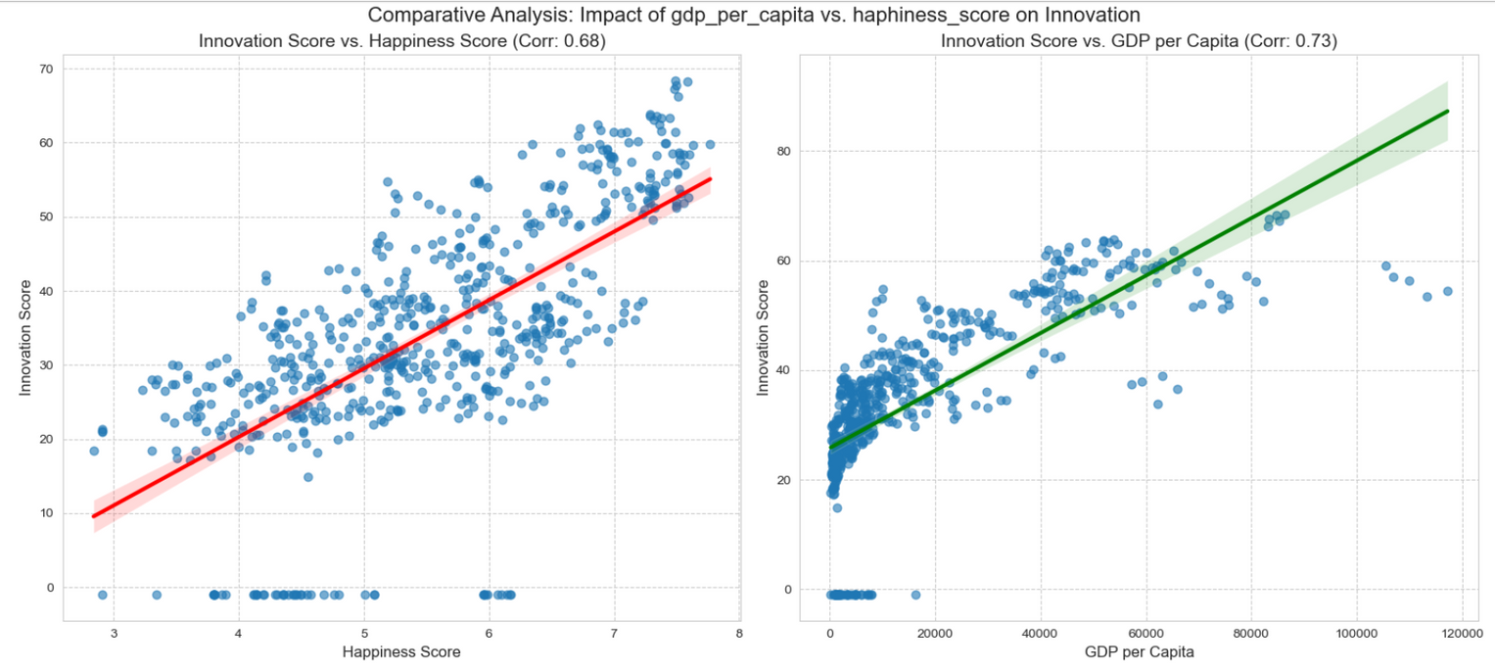
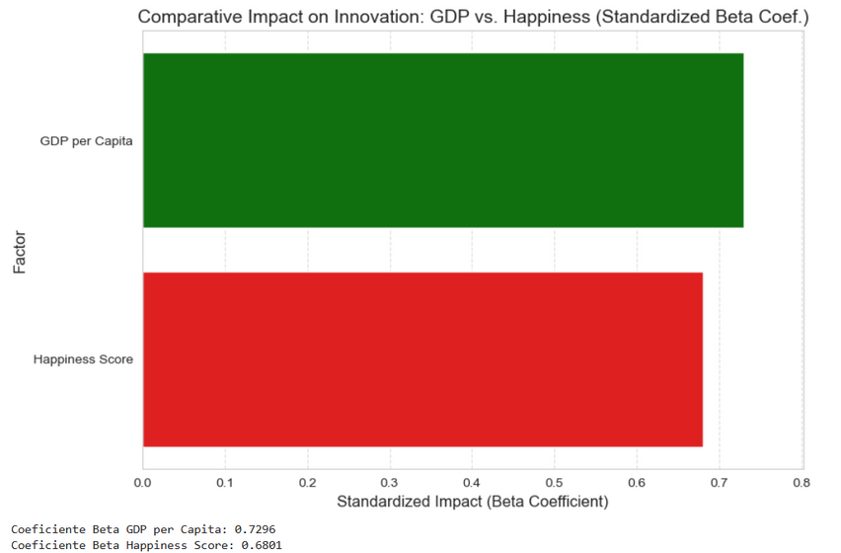
Visualization

Slide 9
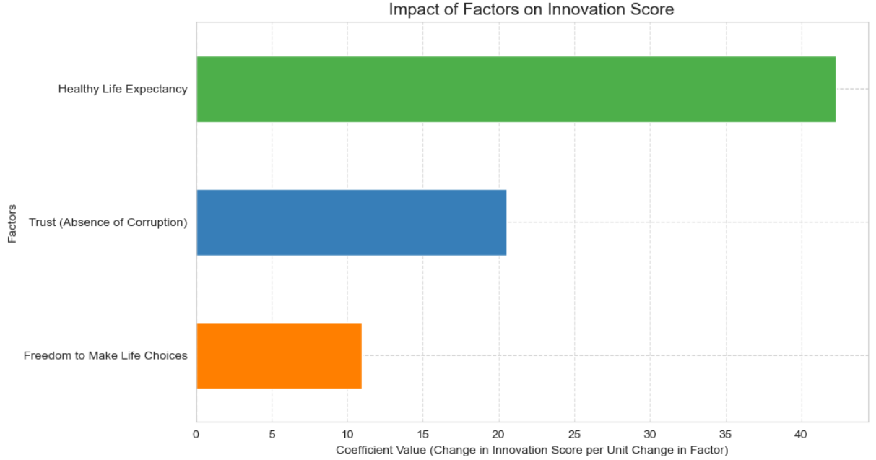
Visualization

Slide 10

Conclusion
Everything is connected!
Not only GDP, but also social factors, health and good government ⟶ impact positively on innovation (Luxemburg and Qatar case)

Slide 11

Obstacles and learnings
Working with SQL database
Teamwork is dreamwork :)

Slide 12


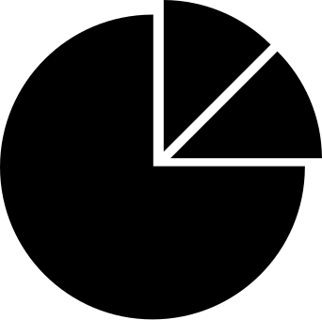

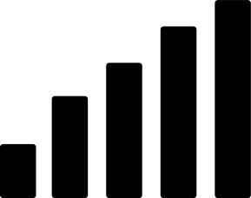
António and Sofia
Happyconomics team
Thank you!

